Slide 1
Green University of Bangladesh
Department of Computer Science & Engineering
Database System Lab
CSE-210

Slide 2
Super Shop Management System

Slide 3

Presented to
Fatema-Tuj- Johora
Lecturer
Dept. of CSE

Slide 4
Presented by
Shagor Kumar Das
201002403
DI

Slide 5
TABLE OF CONTENTS
OBJECTIVES
ER-DIAGRAM
01
02
ANALYSIS OF OUTPUTS
CONCLUSIONS
03
04

Slide 6

01
OBJECTIVES
Manage the details of Stock, Payments, Sales, Products

Slide 7
GOALS
To automate its existing manual system by the help of computerized equipment and full-fledged computer software

Slide 8



Components
an abbreviation for cross-platform, Apache, MySQL, PHP and Perl, and it allows you to build WordPress site offline, on a local web server on your computer.
MySQL is an open-source relational database management system.
XAMPP
MySQL

Slide 9
Entity Relations

Slide 10
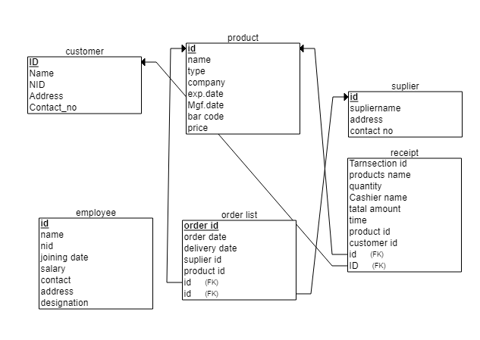
Relational Schema

Slide 11
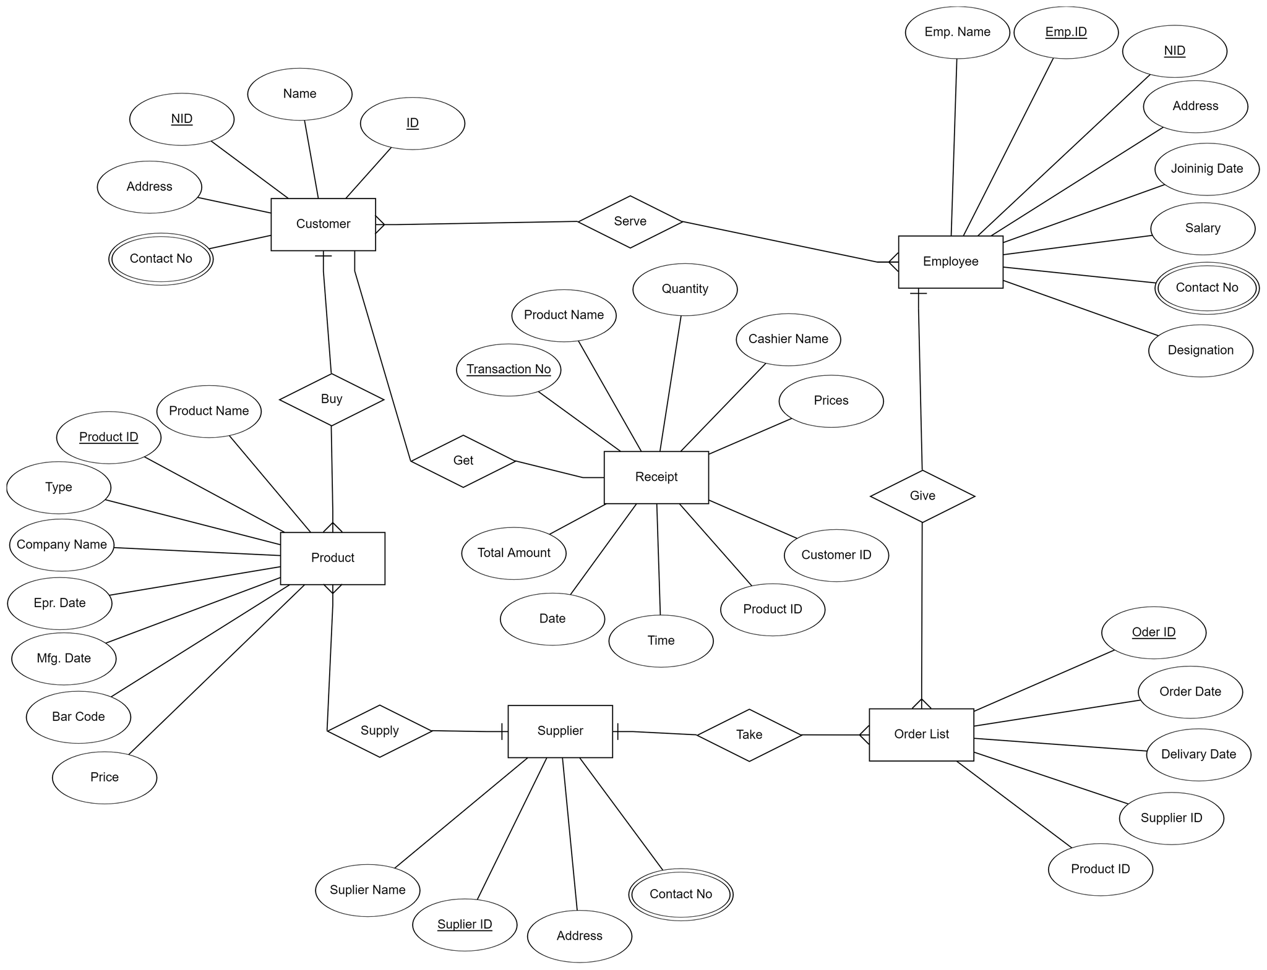
ER- Diagram

Slide 12
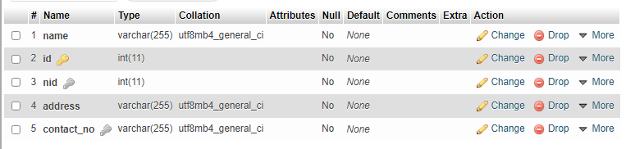
Customer table.
CREATE TABLE customer(
name varchar(255) NOT null,
id int NOT null PRIMARY KEY,
nid int UNIQUE NOT null,
address varchar(255) not null,
contact_no varchar(255) UNIQUE NOT null
);

Slide 13
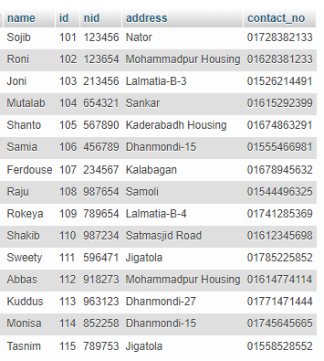
Customer table.

Slide 14
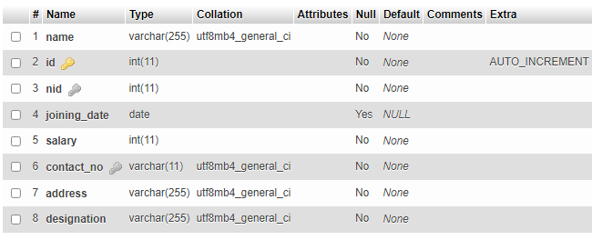
Employee table.
CREATE TABLE employee(
name varchar(255) NOT null,
id int PRIMARY KEY UTO INCREMENT,
nid int UNIQUE NOT null,
joining_date DATE,
salary int NOT null,
contact_no varchar(11) not null UNIQUE,
address varchar(255) not null,
designation varchar(255) NOT null
);

Slide 15
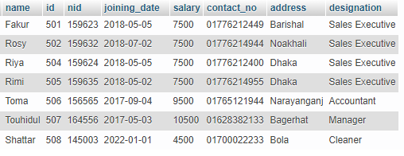
Employee table.

Slide 16
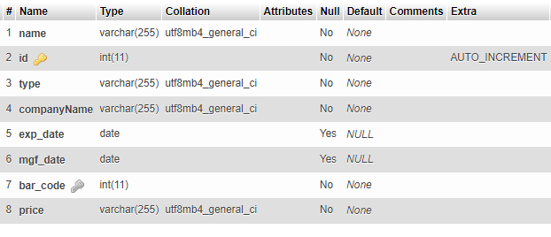
Product table.
CREATE TABLE product(
name varchar(255) not null,
id int NOT null PRIMARY key AUTO_INCREMENT,
type varchar(255) not null,
companyName varchar(255) not null,
exp_date date,
mgf_date date,
bar_code int not null UNIQUE ,
price varchar(255) not null
);

Slide 17
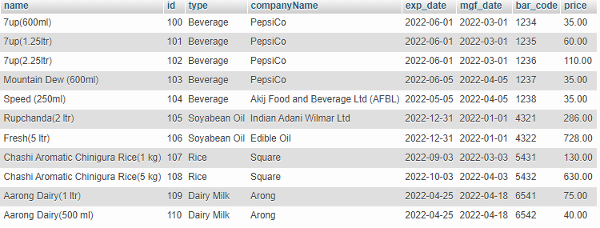
Product table.

Slide 18
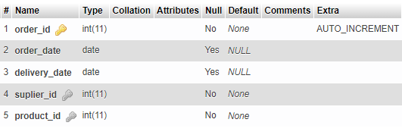
Order list table.
CREATE TABLE order_list(
order_id int not null PRIMARY KEY,
order_date date,
delivery_date date,
suplier_id int not null,
product_id int not null,
FOREIGN KEY(suplier_id) REFERENCES suplier(id),
FOREIGN KEY(product_id) REFERENCES product(id)
);

Slide 19
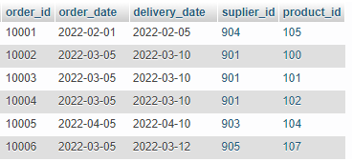
Order list table.

Slide 20
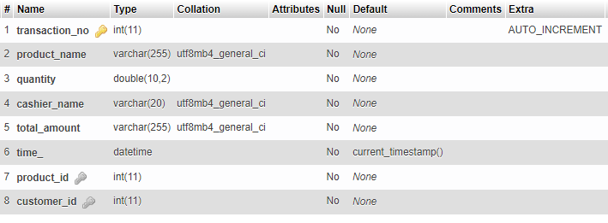
Receipt table.
CREATE TABLE receipt(
transaction_no int not null PRIMARY KEY AUTO_INCREMENT,
product_name varchar(255) not null,
quantity DOUBLE(10,2) not null,
cashier_name varchar(20) NOT null,
total_amount varchar(255) not null,
time_ datetime not null DEFAULT CURRENT_TIMESTAMP(),
product_id int not null,
customer_id int not null,
FOREIGN key(product_id) REFERENCES product(id),
FOREIGN key(customer_id) REFERENCES customer(id)
);

Slide 21
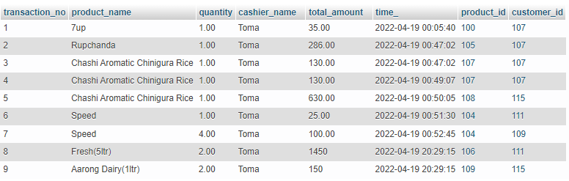
Receipt table.

Slide 22
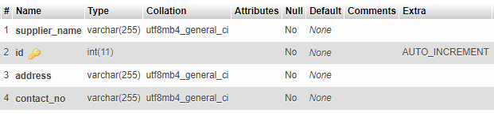
suplier table.
CREATE TABLE suplier(
supplier_name varchar(255) not null,
id int not null PRIMARY KEY AUTO_INCREMENT,
address varchar(255) not null,
contact_no varchar(255) not null
);

Slide 23
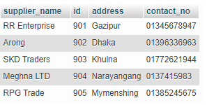
Supplier table.

Slide 24
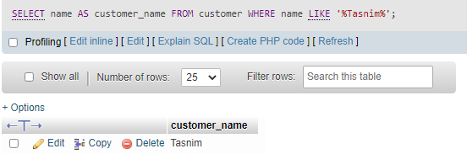
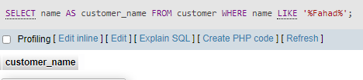
ANALYSIS OF OUTPUTS BASED on QUERIES
String matching operation:
Search a name from a table:
SELECT name AS customer_name FROM customer WHERE name LIKE '%Tasnim%';

Slide 25
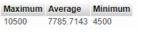
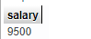
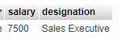
Aggregate function
Find minimum, average & maximum salary from employee table:
SELECT MAX(salary)AS Maximum, AVG(salary) AS Average, MIN(salary) AS Minimum FROM employee;
Find the 2nd maximum salary from employee:
SELECT MAX(salary)AS salary FROM employee WHERE salary < (SELECT MAX(salary) FROM employee);
Find the 3rd or nth maximum salary from employee:
SELECT salary,designation FROM employee ORDER BY salary DESC LIMIT 3,1;

Slide 26
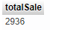
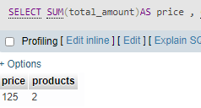
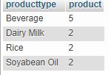
Aggregate function
For total sale:
SELECT SUM(total_amount) as totalSale FROM receipt;
How many times a specific product sold and its total amount:
SELECT SUM(total_amount)AS price , COUNT(product_id)AS products FROM receipt WHERE product_name='Speed';
How many products we have based on their group in our store:
SELECT type AS producttype, COUNT(type) as product FROM product GROUP BY type;

Slide 27
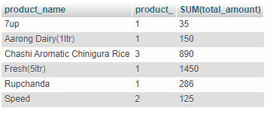
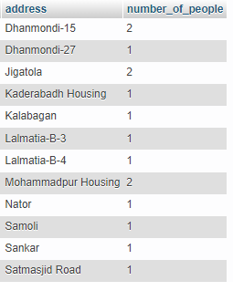
selected products of required quantity and their total amount of money:
SELECT product_name,COUNT(quantity) AS product_,SUM(total_amount) from receipt GROUP BY product_name;
which area contain how many number of people:
SELECT address , count(id) AS number_of_people FROM customer GROUP BY address;

Slide 28
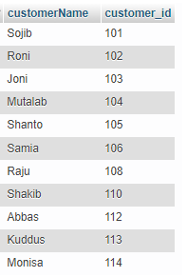
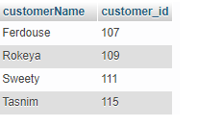
EXISTS function
Display the name of customers who has not made any purchase yet:
SELECT name as customerName, id as customer_id FROM customer WHERE not EXISTS(select * FROM receipt WHERE customer.id=receipt.customer_id);
Display the name of the customer who has made purchase:
SELECT name as customerName, id as customer_id FROM customer WHERE EXISTS(select * FROM receipt WHERE customer.id=receipt.customer_id);

Slide 29
Join operations

Slide 30
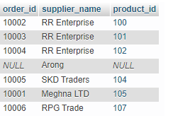
which product has been ordered from which supplier:
------------------------------------------------------------------------------------------
SELECT order_id,supplier_name,product_id FROM order_list RIGHT OUTER JOIN suplier on(order_list.suplier_id=suplier.id);

Slide 31
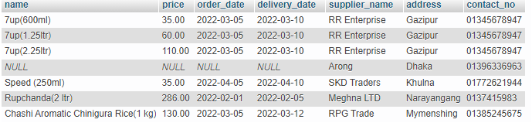
Multiple Join operations
Name of product, price, ordering date, delivery date, supplier name ,supplier address and supplier contact:
------------------------------------------------------------------------------------------
SELECT product.name,product.price, order_list.order_date,order_list.delivery_date,suplier.supplier_name,suplier.address,suplier.contact_no
FROM ((product RIGHT JOIN order_list ON product.id=order_list.product_id)RIGHT JOIN suplier ON order_list.suplier_id=suplier.id);

Slide 32
Conclusion

Slide 33
THANK YOU

